Slide 1

J&K
Presented by: Group 3

Slide 2







Team Members
Founder of Data Department
Strategic Planning Advisor
Strategic Planning Advisor
Sponsor: Sanjiv Koshal
Data Engineer & Visualization Specialist
Market Dynamics Analyst
Recommendations Presenter

Slide 3

Overview
Executive Summary: Highlights the key problem and market dynamics.
Market Trends by Product: Detailed analysis of claims, patient percentages, and HCP adoption for each product.
Regional and Specialty Insights: Exploration of top-performing territories and diagnosis specialties driving the market.
Demographic and Writer Trends: Breakdown of patient age groups and HCP loyalty across products.
Recommendations: Strategies to revitalize Product 2’s market share and build on potential opportunities.

Slide 4

Executive Summary
Problem Statement: While Product 2 was supposed to overtake Product 1’s market share, Product 3 ended up eating both of their market shares
We wanted to figure out what is causing this problem and how can we reverse the trend of losing market share
We propose to:
- Leverage Product 1’s branding and recognition
- Reduce Product 2’s original branding
- Stop short term bleeding using financial incentives, strategic targeting
ThePhoto by PhotoAuthor is licensed under CCYYSA.

Slide 5
Market Basket
Product | Procedure Code | Generic Name | Product Description
Product 1 | J1885 | ketorolac tromethamine | Ketorolac is used for the short-term treatment of moderate to severe pain in adults. It is usually used before or after medical procedures or after surgery
Product 2 / Variant Brand | J2250 | midazolam hydrochloride | Intravenously injected for induction of general anesthesia
Product 3 / Competitor Brand | J3010 | fentanyl citrate | For analgesic action of short duration during the anesthetic periods, premedication, induction, and maintenance, and in the immediate postoperative period (recovery room) as the need arises
Product 4 | J2704 | propofol | Propofol injection is used to help you relax or sleep before and during surgery or other medical procedures. This medicine is an anesthetic and a sedative

Slide 6
Claims Percentage by Product per Year
J1885 (Product 1) Declining Despite Dominance:
J1885 still commands the largest share (58.9% in 2018), but the steady loss (-14.8%) reflects increased competition from J3010 and J2704.
J2250 (Product 2) Struggles:
J2250’s decline to 5.4% in 2018 signifies a loss of relevance. Its inability to maintain market position suggests weak differentiation and lack of engagement strategies.
J3010 (Product 3) Leading the Market Shift:
The sharp +14.5 percentage point growth highlights its success in capturing market share.
The product’s ability to nearly double its share suggests strong differentiation, prescriber confidence, and effective marketing.
J2704 (Product 4) Emerging:
J2704, while small, grew from 1.9% to 6.9%, signaling opportunities for targeted growth.
Notes:
For Product 1 (J1885): Stabilize Market Position
Conduct prescriber engagement programs to retain HCP loyalty.
Highlight key differentiators and clinical benefits to combat the competitive threat from Product 3.
For Product 2 (J2250): Address Underperformance
Focus on targeted campaigns in territories where Product 3 is gaining traction.
Offer incentives and rebates to improve adoption among prescribers.
Strengthen product messaging to highlight unique benefits and address perceived shortcomings.
For Product 3 (J3010): Maintain Growth Momentum
Capitalize on strong adoption trends with expanded outreach and education programs.
Reinforce competitive advantages to sustain growth and further capture market share.
For Product 4 (J2704): Explore Niche Opportunities
Invest in market research to identify specific segments where growth is possible.
Leverage partnerships and HCP education to build a steady presence.

Slide 7
Patients Percentage by Product per Year
Product 1 (J1885) Losing Leadership:
J1885, though still the market leader at 51.30%, has lost dominance by over 15 percentage points.
Product 2 (J2250) Underperforming:
J2250’s share declined by 44%, dropping from 12.97% to 7.20%, indicating a lack of competitive positioning and engagement strategies.
Product 3 (J3010) Leading Growth:
J3010 shows strong and consistent growth, with its market share increasing by 14 percentage points over two years.
This product is capturing market share from J1885 and J2250, indicating strong adoption strategies and competitive advantages.
Product 4 (J2704) Gaining Traction:
Market share rose from a negligible 2.68% in 2016 to 9.30% in 2018.
This is a 3.5x increase, indicating emerging potential in niche markets
Notes:
For Product 1 (J1885): Stabilize Declining Market Share
Reassess competitive positioning and strengthen messaging on clinical benefits.
Launch targeted prescriber engagement and loyalty programs to retain HCPs.
Offer rebates or pricing incentives to improve competitiveness against J3010.
For Product 2 (J2250): Address Decline
Identify and address reasons for underperformance through market research.
Differentiate product offerings with value propositions focused on pricing, outcomes, or convenience.
Target underperforming territories with education campaigns and HCP incentives.
For Product 3 (J3010): Sustain Growth Momentum
Expand marketing and outreach programs to capitalize on growing market share.
Strengthen HCP relationships and ensure continued prescriber support.
Use real-world evidence or success stories to maintain competitive momentum.
For Product 4 (J2704): Build on Emerging Potential
Focus on niche markets and territories with high growth potential.
Increase visibility through targeted marketing and education initiatives.
Explore partnerships to accelerate adoption and market presence.

Slide 8
HCPs Percentage by Product per Year
Product 3 (J3010) Rapid Growth:
J3010 is gaining market share steadily and now holds 32.16% of the market.
This growth likely comes at the expense of J1885 and J2250, as prescribers shift preference to J3010.
Product 1 (J1885) Declining Leadership:
J1885 remains the market leader with 34.09%, but its decline from 41.31% indicates vulnerability to competitors.
Loss of market share suggests competitive challenges and reduced HCP loyalty.
Product 2 (J2250) Struggling to Compete:
J2250 has seen a steep drop to 15.46%, losing 35% of its market share over two years.
This signals weak positioning, poor prescriber retention, or lack of differentiation.
Product 4 (J2704) Emerging as a Competitor:
J2704 tripled its market share, growing to 18.28% in 2018.
This growth highlights J2704’s potential in niche markets, possibly due to pricing advantages or clinical benefits.

Slide 9
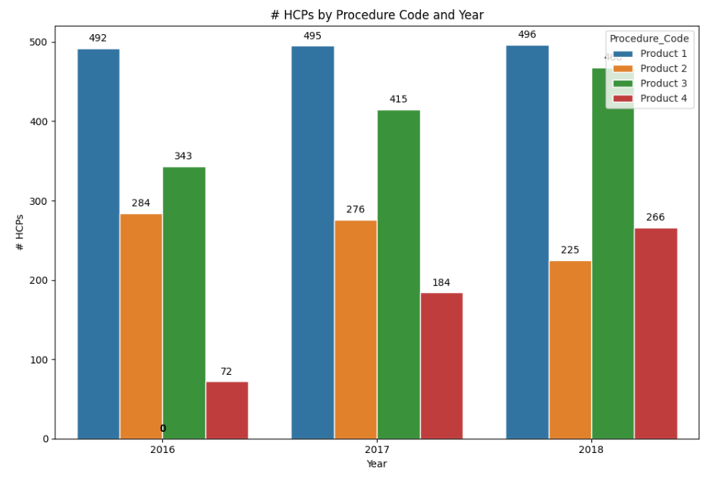
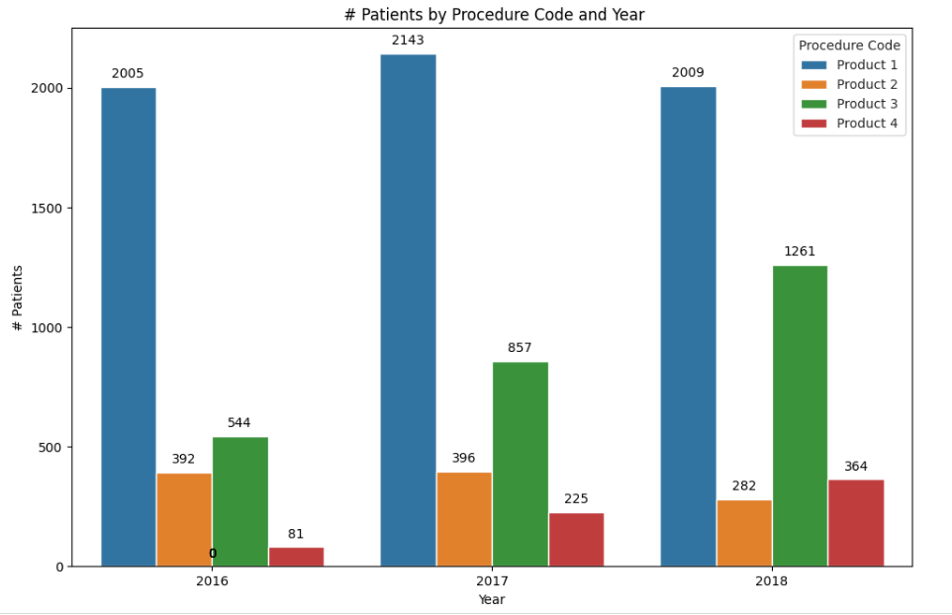
Consistently Leads
36%
Growth is negligible
466
21%
2.3x
3.7x
4.5x
28%
Product 3 (J3010) Dominance:
Product 3 has emerged as the fastest-growing product with 2.3x growth in patients and a 36% increase in HCPs.
Effective HCP engagement and clinical adoption are driving its market share expansion.
Product 1 (J1885) Stability:
Product 1 remains the market leader but shows stagnation with negligible growth in both HCPs and patients.
Signals market saturation and a need for innovation or differentiation.
Product 2 (J2250) Decline:
Sharp decline in both HCP engagement (-21%) and patient numbers (-28%).
Indicates reduced competitiveness, poor targeting, or lack of effective market messaging.
Product 4 (J2704) as an Emerging Competitor:
Product 4 has experienced exponential growth in both patients (+4.5x) and HCPs (+3.7x).
Rapid adoption signals a positive response from the market, positioning J2704 as a strong contender for future growth.
Distribution of Patients and HCP’s by Age Group and Procedure Code
Notes:
Reposition and Revive Product 2 (J2250):
HCP Targeting: Focus on specialties with high market potential, such as Anesthesiology, Cardiology, and Orthopedics, where Product 4 (J2704) is gaining traction.
Market Messaging: Improve clinical messaging to highlight the unique benefits and outcomes of J2250.
Promotional Efforts: Engage HCPs through digital platforms, training programs, and CME (Continuing Medical Education) initiatives.
Sustain Product 3 (J3010) Growth:
Increase investment in high-performing HCP groups and patient segments to maintain momentum.
Expand outreach to additional territories and reinforce positive clinical outcomes to solidify market leadership.
Boost Product 4 (J2704):
Leverage its strong growth trajectory by targeting underserved market segments.
Increase visibility and trial adoption among HCPs to accelerate uptake.
Invest in marketing efforts that emphasize J2704’s clinical efficiency and emerging success.
Reinforce Product 1 (J1885):
Introduce innovative features or additional support programs to retain HCP loyalty and patient preference.
Explore expansion into adjacent market segments to address saturation.

Slide 10
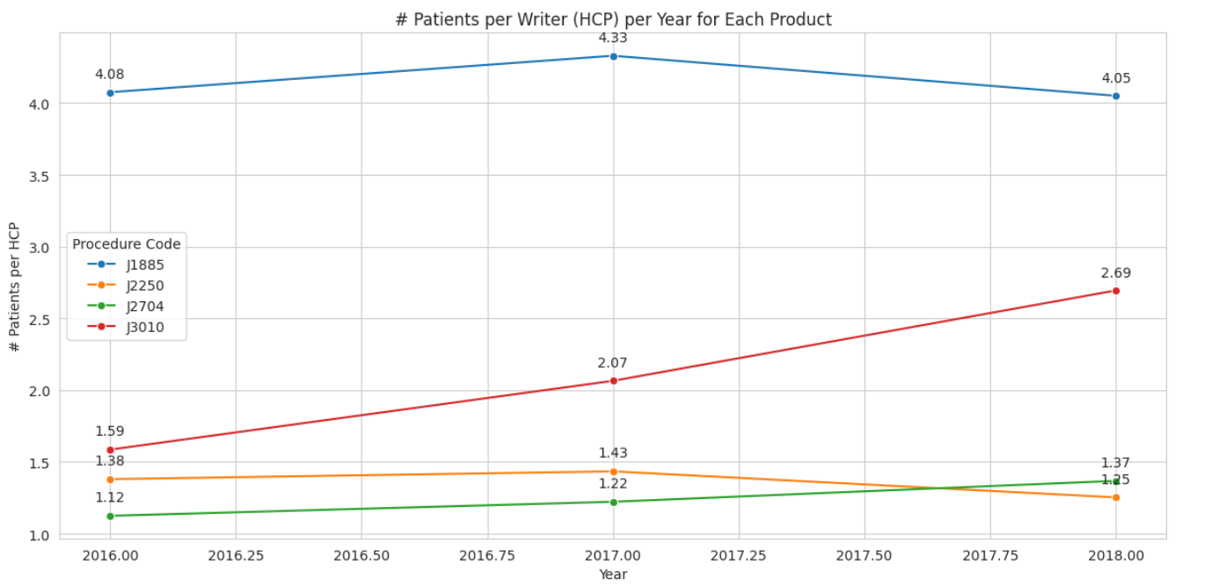
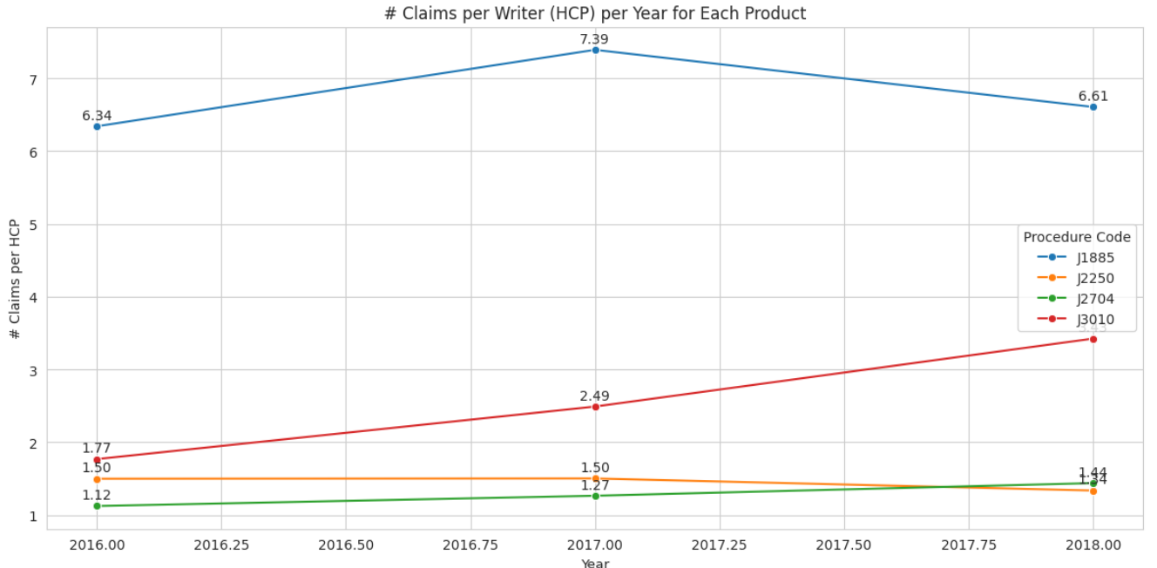
Distribution of Patients and Claims by Age Group and Procedure Code
Stable but slightly declining after 2017.
Peaked in 2017 but dropped in 2018.
69%
86%
22%
Slight Decline, Stagnant Performance
28%
9.4%
J3010 (Product 3):
High Growth: Significant increases in both patients and claims per writer show strong prescriber engagement.
Market Appeal: J3010 is rapidly gaining market preference over J1885 and J2250.
J1885 (Product 1):
Stable but Declining: Remains a leader but shows signs of erosion in both claims and patients per writer.
Competition Threat: J3010 is actively capturing J1885’s market share.
J2250 (Product 2):
Underperforming: Consistent decline in patients and claims per writer highlights poor market retention and lack of differentiation.
J2704 (Product 4):
Promising Growth: Demonstrates steady improvement, with a 28% growth in claims per writer and 22% in patients per writer.
Positioned as an emerging competitor to challenge J1885 and J2250.
Notes:
For J1885 (Product 1): Stabilize Market Leadership
Focus on HCP retention programs to maintain high patient and claim volumes.
Launch competitive campaigns to counter J3010’s rising momentum.
Improve HCP engagement through targeted educational initiatives and incentives.
For J2250 (Product 2): Revive Market Presence
Conduct market research to understand declining performance.
Differentiate J2250 with improved pricing, enhanced clinical messaging, and better support programs.
Implement targeted campaigns to re-engage disengaged HCPs.
For J3010 (Product 3): Sustain Rapid Growth
Expand into underpenetrated regions to capture more market share.
Reinforce prescriber education and share real-world outcomes to solidify growth.
Maintain aggressive marketing strategies to stay ahead of competitors.
For J2704 (Product 4): Leverage Emerging Potential
Increase focus on HCP education and build awareness around clinical benefits.
Target regions where J2250 and J1885 are underperforming to capture market share.
Highlight cost-effectiveness and improved adoption rates to attract prescribers.

Slide 11
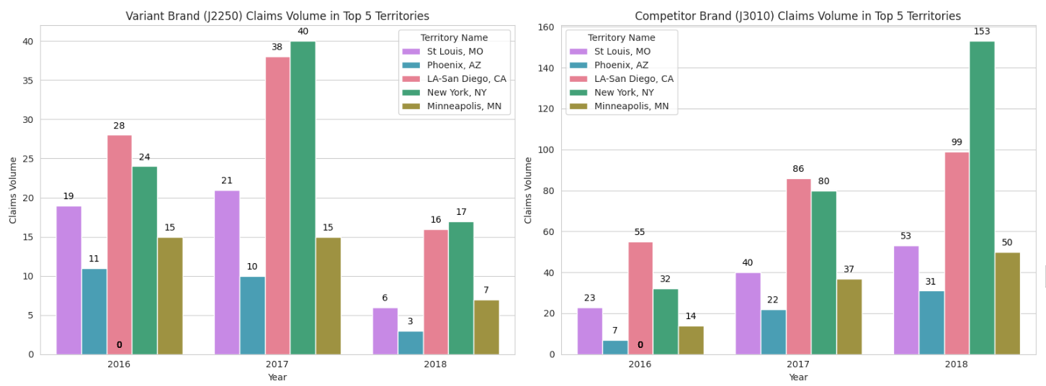
Claims Volume Trends for Product 2 vs Product 3 Across Top 5 Territories
Significant Decline for J2250 (Product 2):
J2250 saw sharp declines (50%-70%) in all five territories, indicating an erosion of market share and lack of retention among HCPs.
Strong Growth for J3010 (Product 3):
In contrast, J3010 experienced growth across all territories, with New York, NY showing a 91% surge in claims volume.
This highlights Product 3's strong brand positioning, superior engagement, and ability to retain HCPs in highly populated regions.
Dominance in Key Territories:
New York, NY and LA-San Diego, CA are critical markets where J3010 is outperforming J2250 by 4x to 6x in claims volume.
Disparity Between Territories:
Highly populated territories like New York and LA-San Diego show immense growth potential for J3010.
Meanwhile, less populated areas like Phoenix and Minneapolis exhibit smaller increases, making them critical targets for mid-term recovery strategies for J2250.
91%
58%
57%
15%
53%
33%
35%
71%
41%
70%

Slide 12
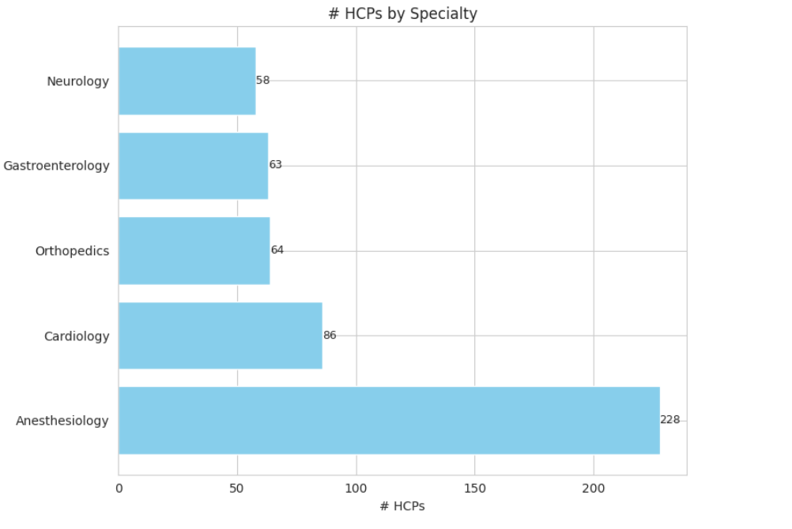
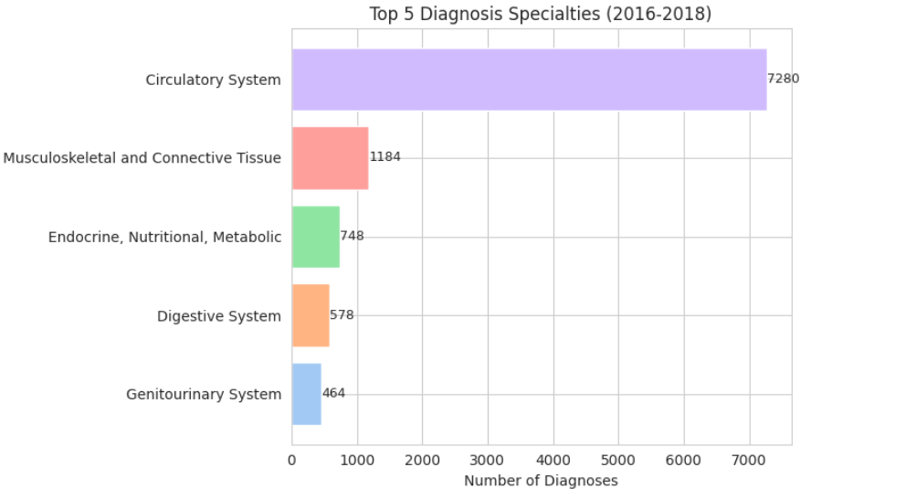
Key Market Drivers of the Injectable Anesthesia Market
75% Of overall data
Top 5 Diagnosis Specialties:
Diagnosis Specialties (Market Driver):
Circulatory System dominates as the leading diagnosis specialty with 7,280
Circulatory System dominance aligns with procedures requiring anesthesia, like cardiovascular surgeries.
The Circulatory System specialty accounts for a significant 75% proportion of diagnoses, suggesting a heavy reliance on injectable anesthetics in cardiovascular procedures.
Product 3 has captured a significant share in this field, while Product 2 lags behind.
HCP Specialties:
Anesthesiology stands out as the key prescribing HCP specialty, significantly larger than all other specialties combined.
Competitor Product 3 likely leverages its alignment with Anesthesiologists and Cardiologists, driving its growth.
The key prescribers must be a central focus for Product 2 to regain traction.
Other fields like Cardiology and Orthopedics represent high potential but are currently underleveraged by Product 2.

Slide 13
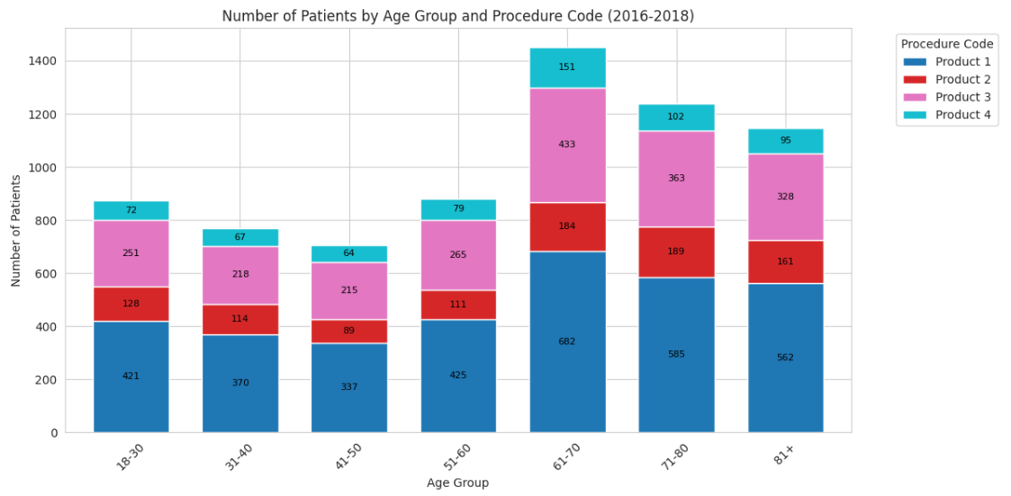
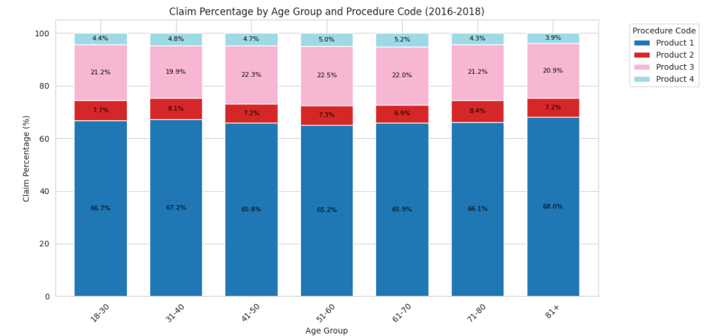
Distribution of Patients and Claims by Age Group and Procedure Code
Product 3 is attracting a growing number of patients and showing consistent claim percentages, particularly among older age groups. This signals that Product 3 is capturing market share in a key demographic where Product 2 is declining.
Product 1 has a firm market leadership position across all age groups with stable demand and high claims.
Product 2 is failing to capture significant demand and contributes minimally to claims. The decline is caused by Product 3's growth, suggesting a need to re-evaluate Product 2's positioning and competitive strategy.
To increase Product 2’s market share, you could consider:
Targeting younger age groups where demand is lower.
Differentiating Product 2 with competitive pricing or features.
Counteracting Product 3’s growth through strategic marketing in older age groups.
Notes:
Plot 1:
High Adoption of Product 1 (J1885):
Product 1 (J1885) consistently leads across all age groups, with significantly higher patient numbers, especially in the 61-70 and 71-80 age ranges.
This indicates strong market dominance and customer preference for Product 1.
Moderate Uptake for Competitor Product 3 (J3010):
Product 3 (J3010) shows steady growth in patient numbers, particularly in older age groups (61-80+), where it rivals J1885's share.
Its growth highlights increasing competitiveness, particularly among older patients.
Lagging Performance of Product 2 (J2250):
Product 2 (J2250) has a relatively lower patient count across all age groups, suggesting it is underperforming and less preferred.
The decline is most evident in older age groups where demand for other products (like J1885 and J3010) increases.
Plot 2:
Dominance of Product 1 (J1885):
Product 1 (J1885) accounts for 65%-68% of total claims across all age groups, showing its dominance and consistent adoption.
The claim percentage stability indicates strong trust and reliance on Product 1.
Growing Claims for Product 3 (J3010):
Product 3 (J3010) consistently contributes 20%-22% of claims in older age groups (51+).
This reflects Product 3's increasing penetration into the market, particularly among older patients.
Low Market Share for Product 2 (J2250):
Product 2 (J2250) shows minimal claim contributions (7%-8%) across all age groups.
Its lower claim percentages indicate a limited role in the overall market, suggesting that customers prefer alternatives
Key Recommendations to Increase Market Share for Product 2:
Position Product 2 as a Value Alternative: Highlight Product 2's benefits in terms of cost-effectiveness or specific features that address patient needs, especially in older age groups.
Target Untapped Segments: Focus on younger age groups (18-50), where J1885 dominates, but Product 2 has an opportunity to capture new patients.
Counter Competitor Product 3 (J3010): Product 3 is steadily growing in older segments. A targeted campaign emphasizing Product 2’s unique selling points can slow Product 3’s momentum.

Slide 14
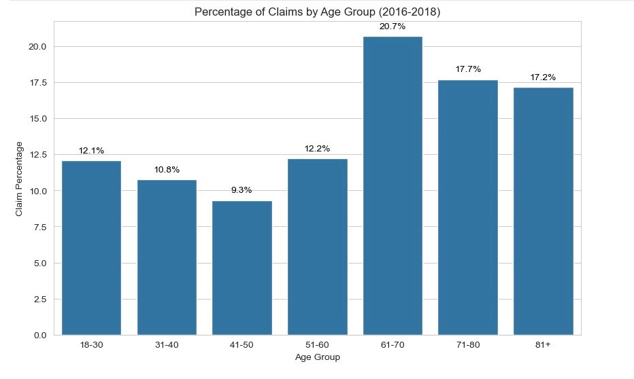
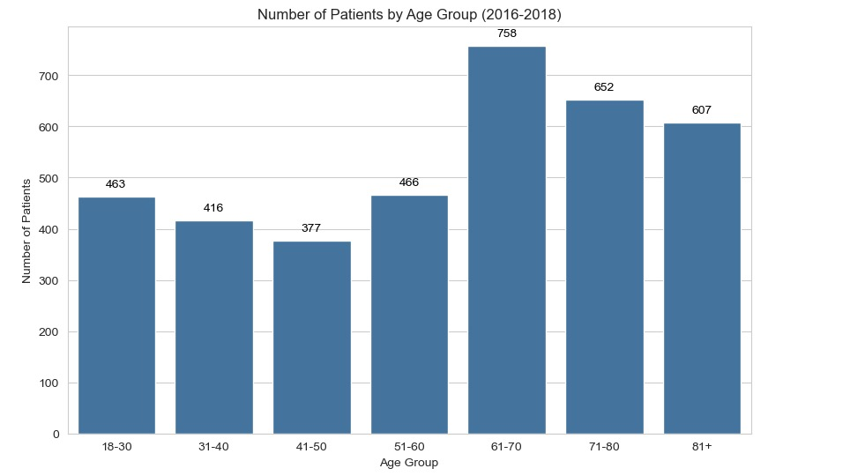
Patient Distribution and Claim Trends Across Age Groups
Targeted Customers
High Demand and High Claims in 61-70 Age Group:
Both patient volume (758) and claim percentage (20.7%) peak in the 61-70 age group.
Product 3 appears to be capturing a significant portion of this segment. To reverse Product 2 (J2250)'s decline, prioritize tailored marketing and promotions for this critical age group.
While the 61-70 age group peaks for both patient volume (758) and claim percentage (20.7%), the 71-80 (652 patients, 17.7% claims) and 81+ (607 patients, 17.2% claims) groups still show significant demand.
Product 3 (J3010) appears to be gaining traction in these older demographics. To address this, Product 2 (J2250) should focus on increasing awareness and offering incentives in these age groups to counter the growth of Product 3.
Underperformance of Product 2 (J2250):
While Product 1 dominates across all groups and Product 3 shows notable growth, Product 2 has relatively low adoption.
Product 2 should focus on improving its market position by:
Highlighting unique benefits or cost advantages.
Partnering with providers to recommend Product 2, especially to the 61-70 and 71-80 age groups.
Notes:
Patient volume in the 18-30 and 31-40 age groups is moderate (463 and 416, respectively), but their claim percentages (12.1% and 10.8%) are significantly lower compared to older groups.
For Product 2 (J2250), this indicates an opportunity to explore alternative positioning, such as preventive care or cost-effective solutions, to improve adoption in younger demographics.
Product 1 (J1885) Dominance Threatens Product 2 (J2250):
Across all age groups, Product 1 (J1885) is the clear leader, contributing to the majority of patient volume and claim percentages.
Product 2 (J2250) must differentiate itself with specific value propositions like lower cost, faster recovery, or unique clinical benefits to compete more effectively.
Potential to Boost Product 2 (J2250) Adoption Through Partnerships:
The combined data shows that older demographics are key drivers for patient volume and claims.
Partnering with healthcare providers to offer discounts, awareness programs, or bundled treatments for the 61-70, 71-80, and 81+ age groups could significantly improve adoption for Product 2.
Focus on Product Positioning and Marketing in High-Impact Segments:
Since the 41-50 age group has both the lowest patient volume (377) and lowest claim percentage (9.3%), targeting efforts here might yield limited returns.
Redirecting marketing efforts toward the 61-70 and 71-80 age groups, where patient volume and claim contributions are highest, can have a greater impact on overall market share.

Slide 15
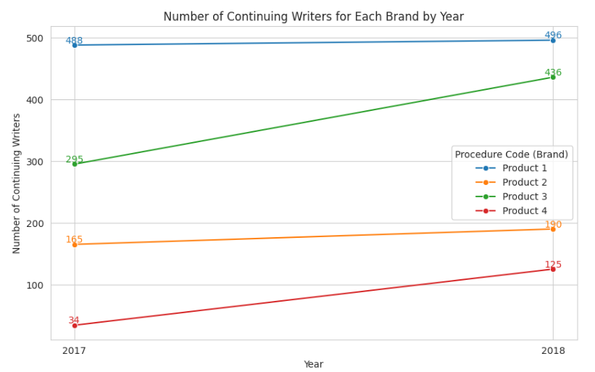
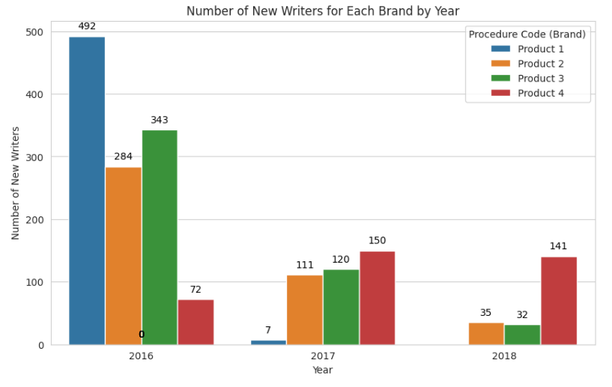
New and Continuing HCP (Writer) Trends for Four Brands
P1 Dropped to '0'
48%
3.5x
0
Product 3 Balanced Growth:
Product 3 shows consistent growth in continuing writers 295 (2017) to 436 (2018)(48% increase) while also retaining some new writers in 2017-2018.
This growth highlights strong retention and increasing adoption among existing healthcare providers (HCPs).
Product 2 Lacks Significant New or Continuing Growth:
Product 2 had low new writer numbers (111 in 2017, 35 in 2018) and minimal growth in continuing writers (165 to 190).
Efforts to attract new HCPs and increase engagement with current ones are critical to reviving growth.
Product 1 Lost Momentum in New Writers:
Product 1 had 492 new writers in 2016, but this dropped sharply to 7 in 2017 and 0 in 2018.
This indicates a significant loss in attracting new HCPs, which could challenge future growth despite its existing strong base.
Product 4 Emerging as a Growth Opportunity:
Despite starting with 72 new writers in 2016, Product 4 saw rapid adoption in 2017 (150 new writers) and consistent growth in continuing writers
Targeted marketing and further HCP engagement can help Product 4 capitalize on this upward trend.
Notes:
Steady but Slow Growth in Continuing Writers:
Continuing writers grew modestly from 165 in 2017 to 190 in 2018, a 15% increase.
While growth exists, it is far slower compared to competitors like Product 3 (J3010), which surged 48% (295 to 436) over the same period.
Low Growth in New Writers:
New writers for Product 2 dropped significantly from 284 in 2016 to 35 in 2018.
This represents an 87% decline, highlighting a major challenge in attracting new prescribers over the three years.
Struggle to Retain New Writers:
In 2016, Product 2 had 284 new writers, but very few converted into long-term prescribers, as seen by the limited growth in continuing writers by 2017 and 2018.
This suggests a failure to sustain interest or loyalty among new HCPs.
Product 2 Need for Engagement and Marketing Focus:
With new writers stagnating and retention being low, Product 2 needs to invest in outreach programs like HCP education, better incentives, or showcasing clinical advantages to attract and retain new prescribers.
Competitive Pressure from Product 3 (J3010):
Product 3 has consistently attracted both new writers (343 in 2016, far above J2250) and retained them effectively with a sharp rise in continuing writers (436 in 2018).
This indicates that Product 3's competitive positioning is stronger and directly impacting Product 2's decline.

Slide 16
Immediate Actions to Stabilize Market Share
Territory Intervention
Focus field force & promotions on top 5 underperforming territories.
Co-pay/Payer Assistance
Offer enhanced support to reduce patient costs and encourage rapid uptake
Targeted Digital Promotions
Use high-impact emails/webinars to quickly re-engage lapsed prescribers.

Slide 17
Strategic Initiatives for Sustainable Growth
Brand Repositioning
Align Product 2 with Product 1’s strong legacy and trust.
Unified branding in all sales & marketing collateral.
HCP Specialty Engagement Programs
Develop tailored education and advisory boards for key specialties
Patient Segment Focus
Target messaging & materials to key patient age groups
Notes:
• Brand Repositioning: Leverage Product 1’s strong equity to position Product 2 as the next-generation successor. Emphasize continuity and trust in future branding and marketing materials. (This is a longer-term strategic shift that involves careful messaging and possibly brand architecture changes.)
• HCP Specialty Engagement Programs: Develop educational modules or advisory boards targeting key HCP specialties that drive competitor adoption. These are more strategic efforts that take time to implement and bear fruit.
• Patient Segment Focus: Refine educational content and support materials for older patient groups. This involves research, adaptation of materials, and building partnerships—all more time-intensive, but ultimately high-impact.

Slide 18

Beyond Current Claims
What’s Missing
Patient Journey Gaps:
No adherence or persistence trends (e.g., therapy drop-offs).
Lack of insights into drug-switching patterns or discontinuation reasons.
Low data on young and privately insured population.
Lacks comprehensive formulary details
No direct correlation between marketing activities (calls, campaigns) and prescription behaviors.
Notes:
What’s Missing & Why It Matters:
1. Payer & Formulary Insights:
• Gap: No direct co-pay, formulary status, or reimbursement data.
• Impact: Without knowing coverage barriers, we can’t precisely target financial interventions (e.g., co-pay cards) where they’ll sway prescribing most.
2. Promo & Call Activity Data (NPA, NSP, CRM):
• Gap: No data on sales rep calls, sample drops, speaker programs, or digital engagements.
• Impact: Can’t tie promotional spend or rep effort to prescribing outcomes, missing a crucial feedback loop to optimize resource allocation and messaging.
3. Competitive Intelligence (Brand-Level):
• Gap: We lack competitor contracting tactics, KOL alignments, or channel investments.
• Impact: Blind to competitor playbooks and unable to craft proactive strategies, especially in territories or specialties where our brand is losing share.
4. Real-World Outcomes & Utilization Patterns:
• Gap: No patient adherence, satisfaction, or outcomes data linked to each product.
• Impact: Inability to position Product 2 as clinically superior or cost-effective in the long term, beyond simple claims volume metrics.

Slide 19
Beyond Current Claims: Fueling Data-Driven Dominance
How Additional Data Would Help:
NPA/NSP Data: Analyze new-to-brand adoption and competitive switches.
DDD Data: Track supply chain bottlenecks and regional distribution trends.
Calls & NPP Data: Correlate promotional activities with prescription uptake.
Notes:
How Additional Data Would Help:
• Payer/Formulary D
• Promo/Call Metrics & Chaata: Identify exactly where to deploy co-pay cards or negotiate better coverage to trigger immediate share gains. nnel Dynamics: Correlate rep activities with market share changes to double down on what works (e.g., HCP specialty-targeted eDetails or local events in high-value territories).
• Competitive Intel: Counter Product 3’s moves with preemptive discounts, targeted messaging, or strategic KOL partnerships.
• Outcomes Data: Highlight Product 2’s real-world benefit—smoother recoveries, fewer complications—to build a compelling story that pulls HCPs and patients away from competitors.

Slide 20




Leveraging ML to Narrow the GAP
Promotion Effectiveness
Use ML models to correlate promotional activities (calls, digital campaigns) with prescription changes.
Predict the most effective promotional strategies for specific regions or physician segments.

Slide 21
Conclusion:
Strategic Rebranding: Capitalize on Product 1's established market presence to boost Product 2's visibility and relevance.
Enhanced HCP Engagement: Increase efforts to retain and engage healthcare providers through targeted educational and promotional activities.
Demographic Focus: Prioritize marketing and sales strategies for age groups demonstrating the highest growth potential, particularly the 61-70 age group.
Data-Driven Decisions: Utilize machine learning models to optimize promotional strategies and improve prescription uptake in key territories.
Immediate Actions: Implement territory-specific interventions and specialty targeting to quickly address areas of underperformance and capitalize on growth opportunities.

Slide 22

THANK YOU

Slide 23

Questions?

Slide 24



FamilyID=Office_ArchiveTorn
Wishing you and your loved ones a joyful and magical holiday season!"

